Slide 1
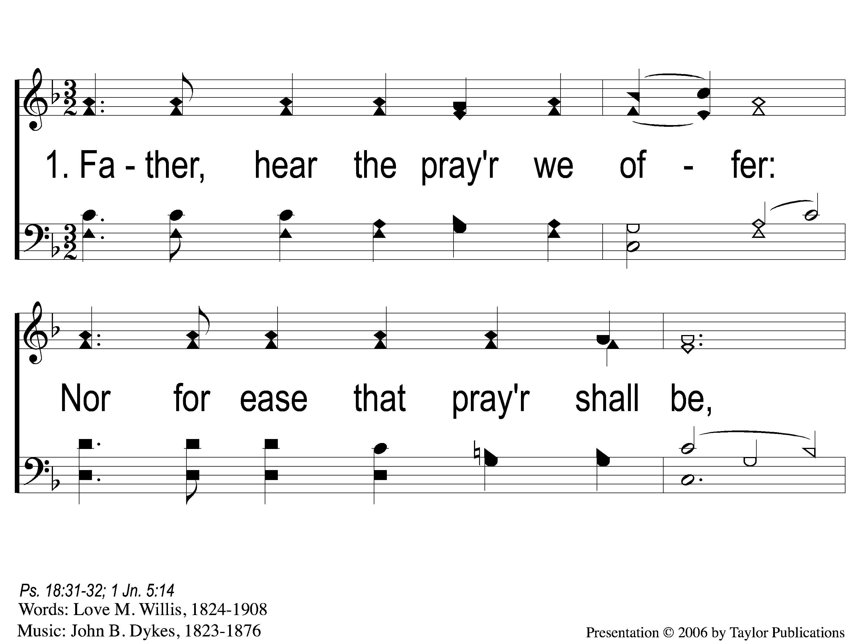
1-1 Father Hear the Prayer we Offer
Father, Hear the Prayer We Offer
54

Slide 2
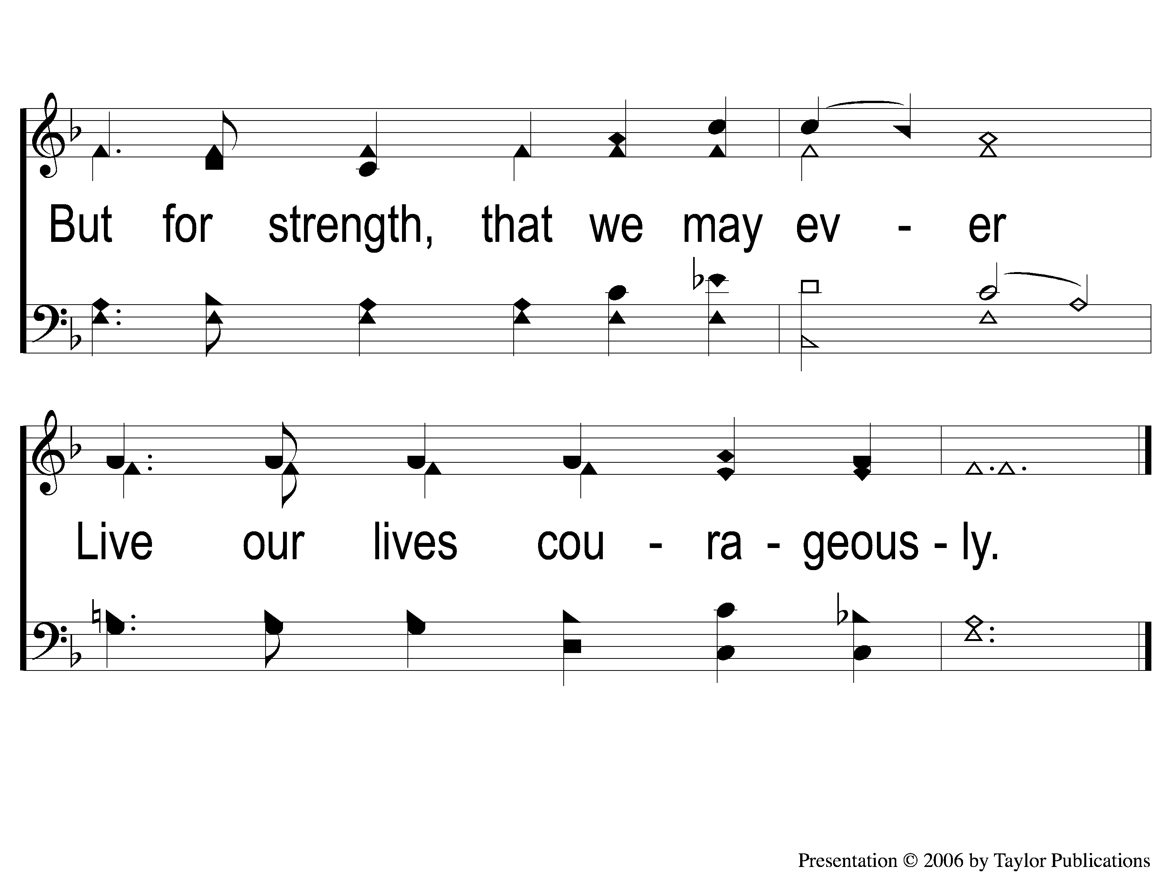
1-2 Father Hear the Prayer we Offer
Father, Hear the Prayer We Offer
54

Slide 3
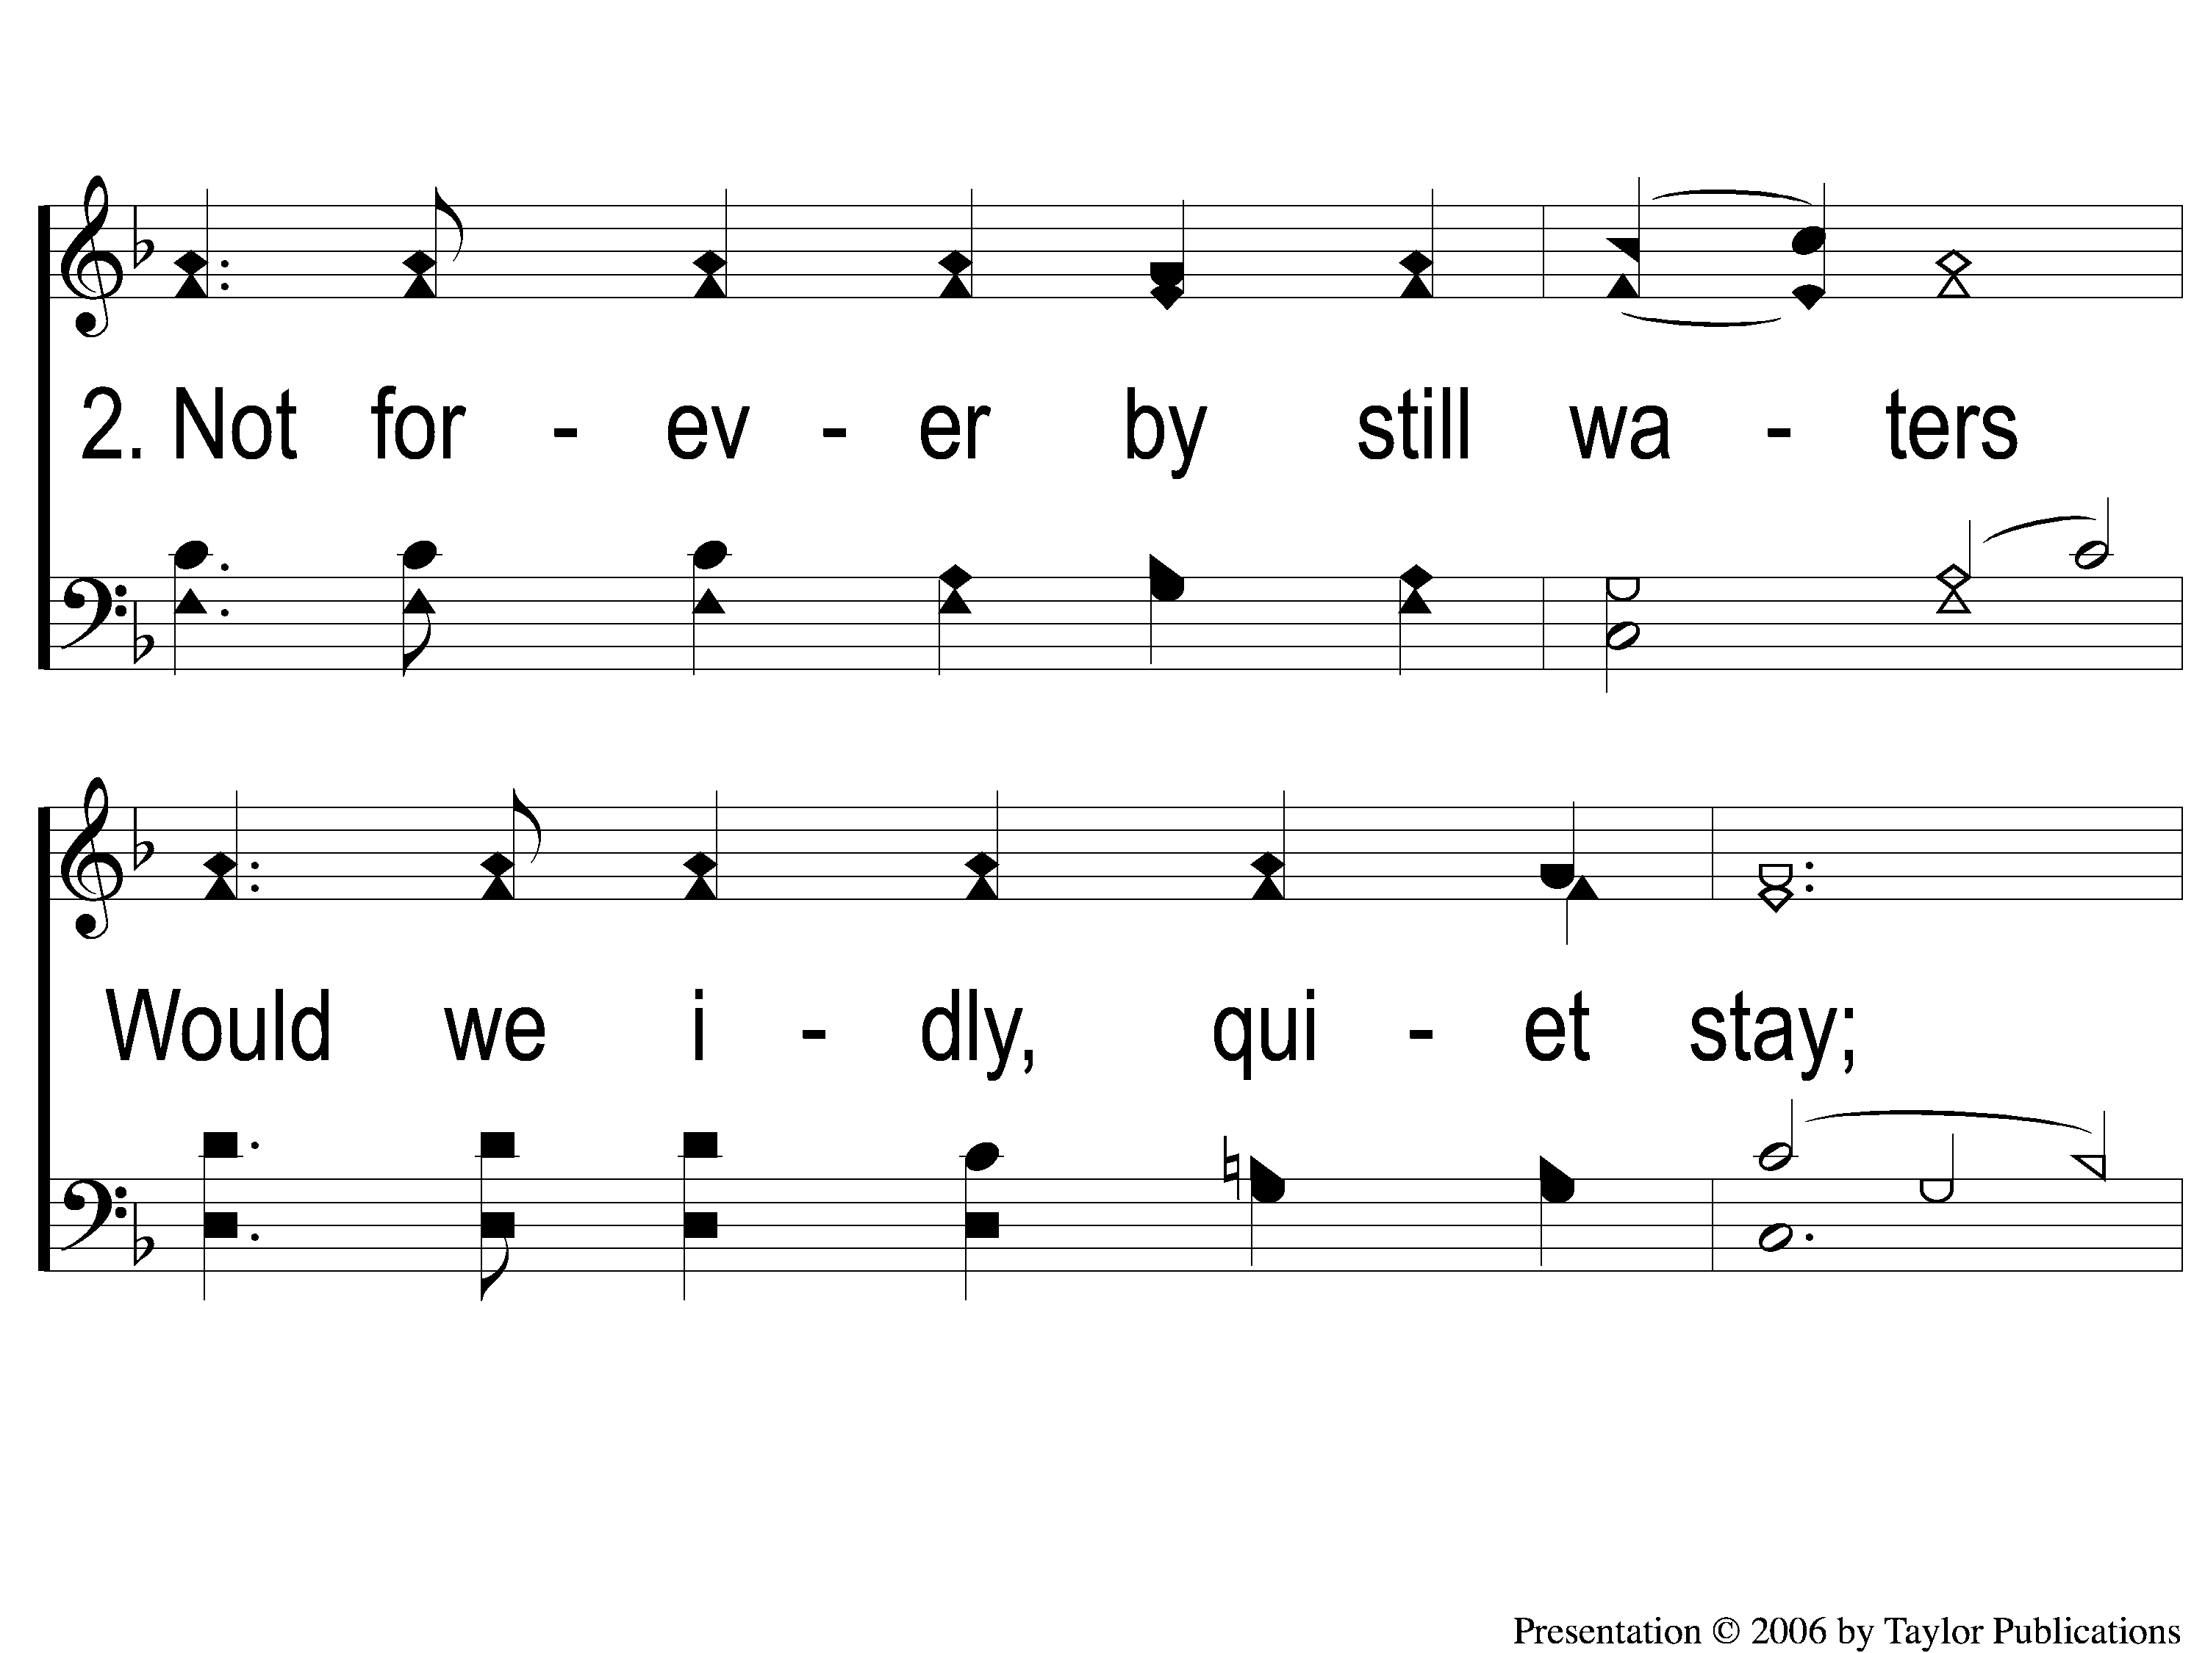
2-1 Father Hear the Prayer we Offer
Father, Hear the Prayer We Offer
54

Slide 4
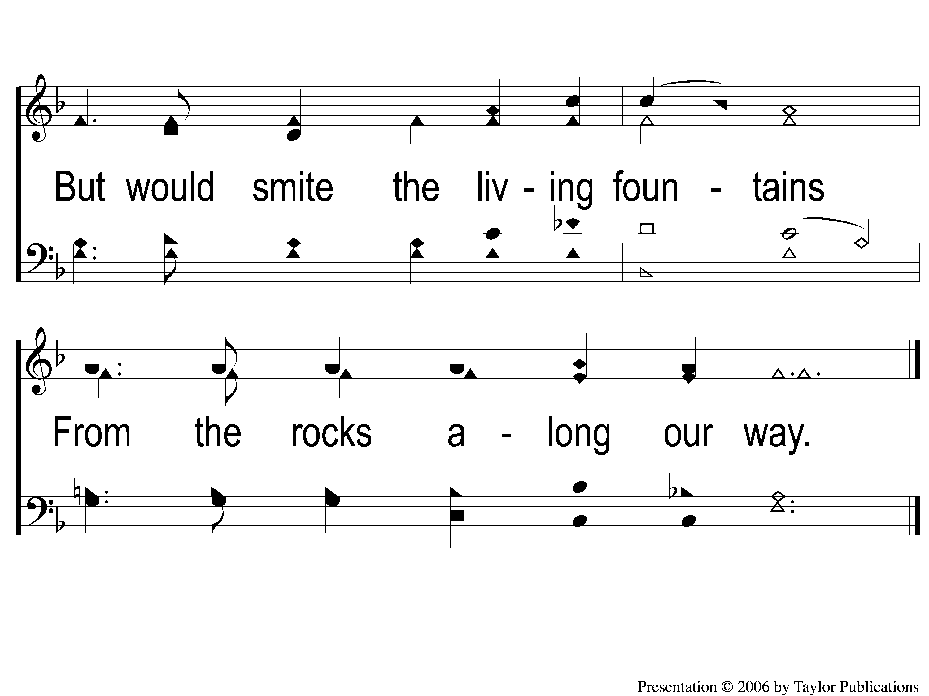
2-2 Father Hear the Prayer we Offer
Father, Hear the Prayer We Offer
54

Slide 5
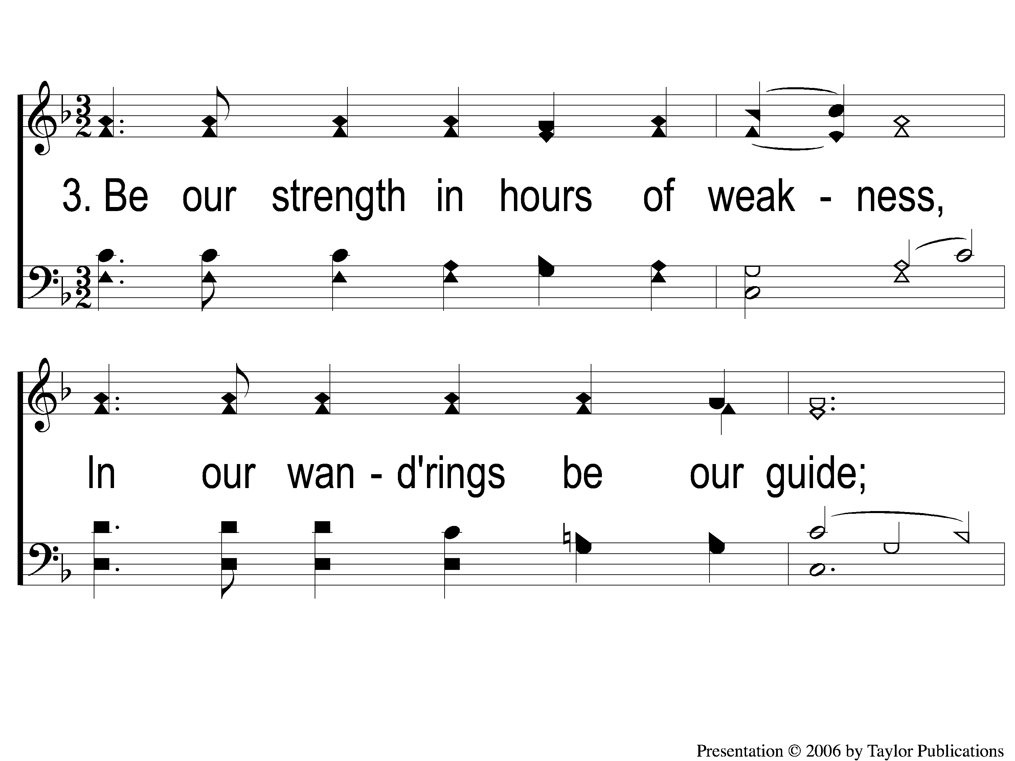
3-1 Father Hear the Prayer we Offer
Father, Hear the Prayer We Offer
54

Slide 6
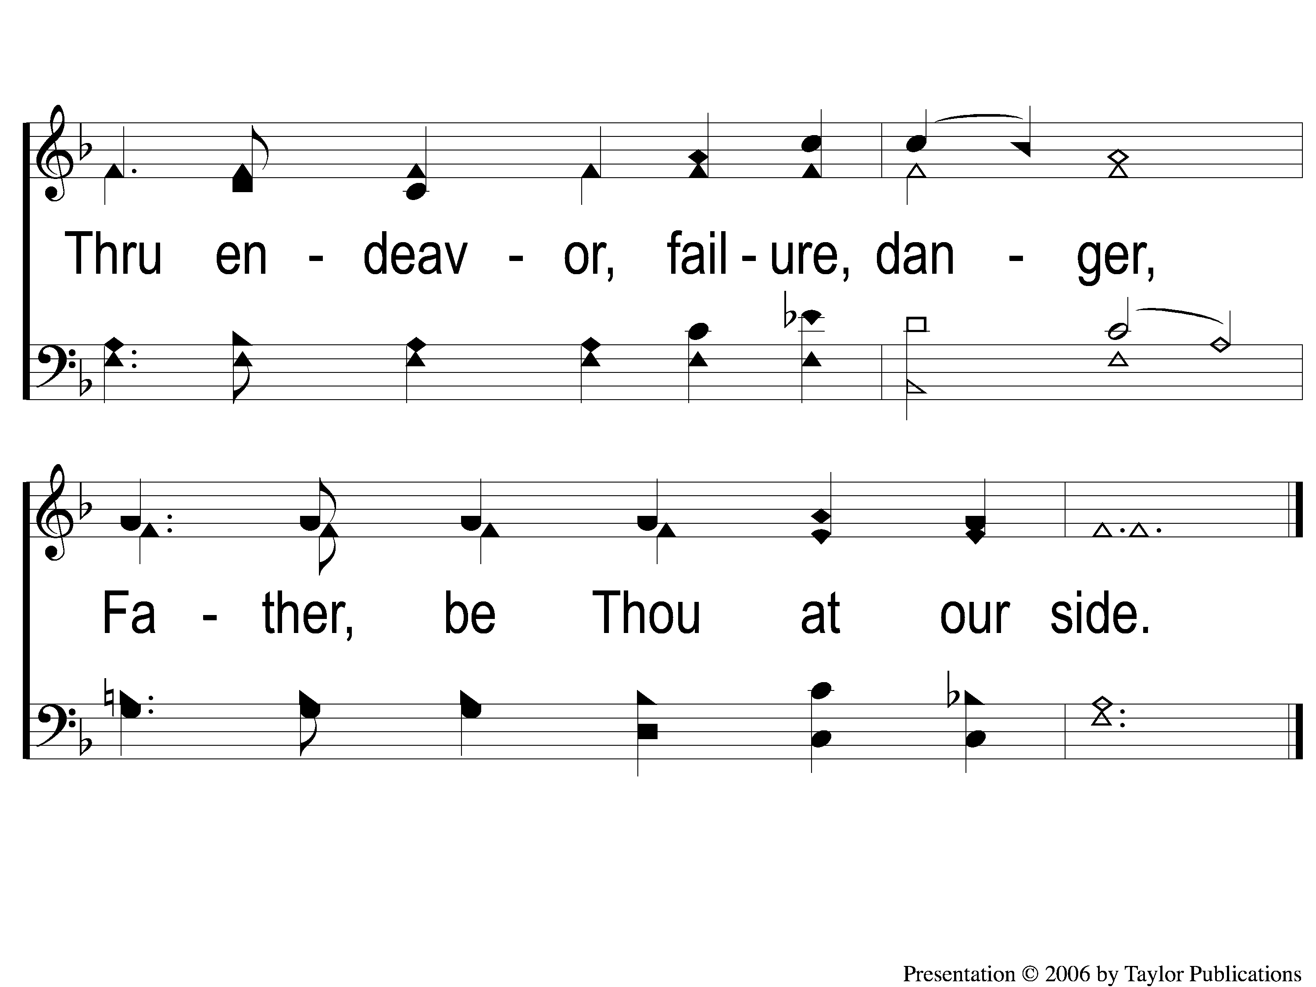
3-2 Father Hear the Prayer we Offer
Father, Hear the Prayer We Offer
54

Slide 7
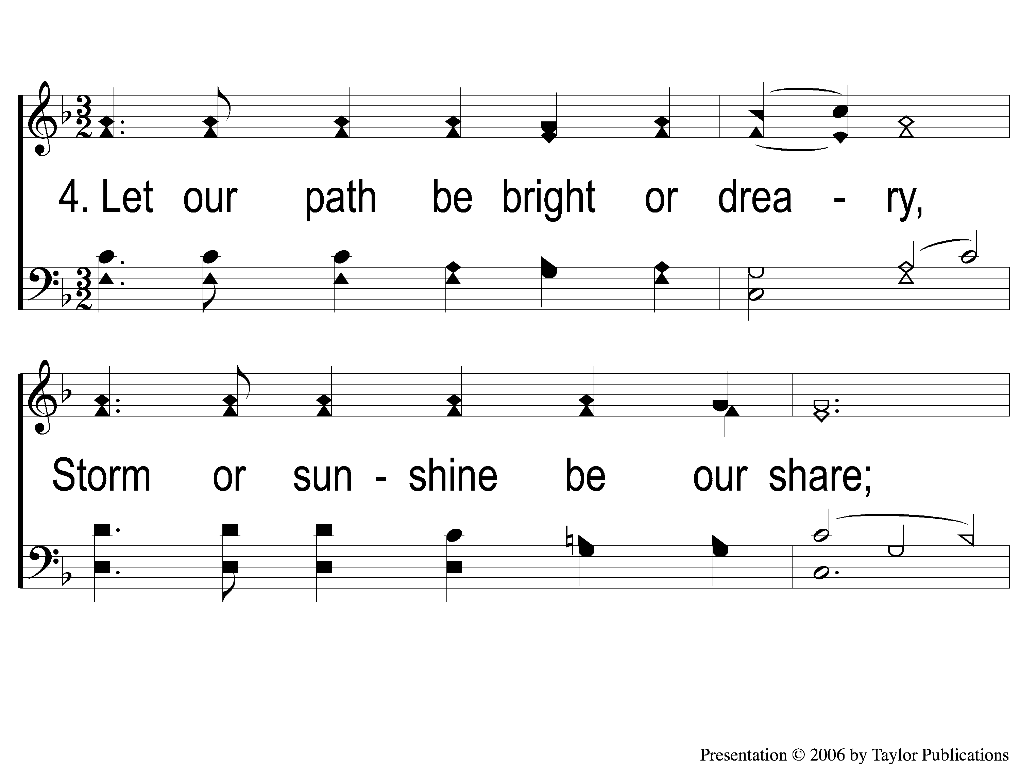
4-1 Father Hear the Prayer we Offer
Father, Hear the Prayer We Offer
54

Slide 8
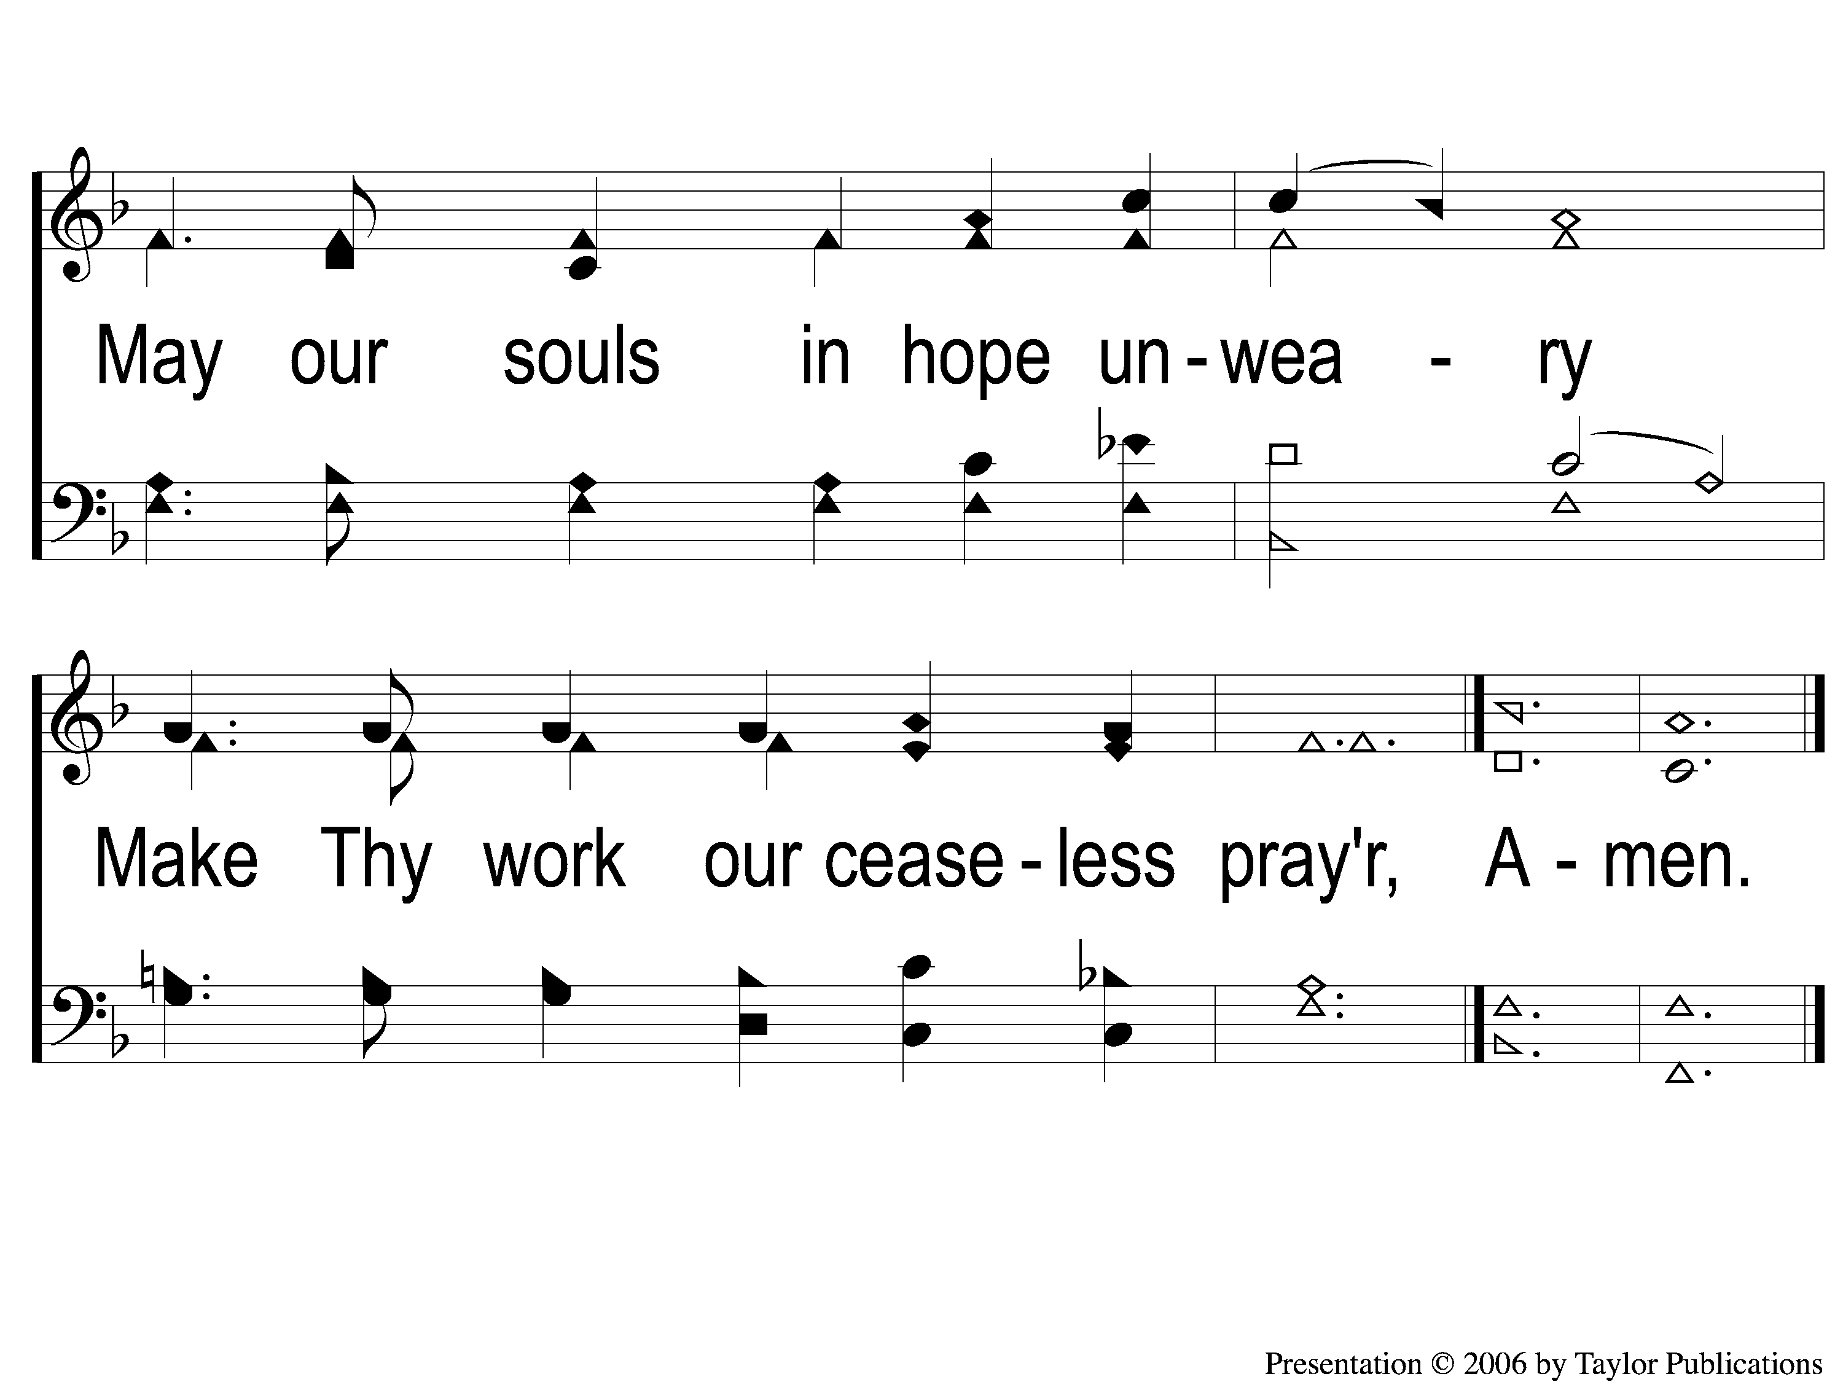
4-2 Father Hear the Prayer we Offer
Father, Hear the Prayer We Offer
54

